Slide 1
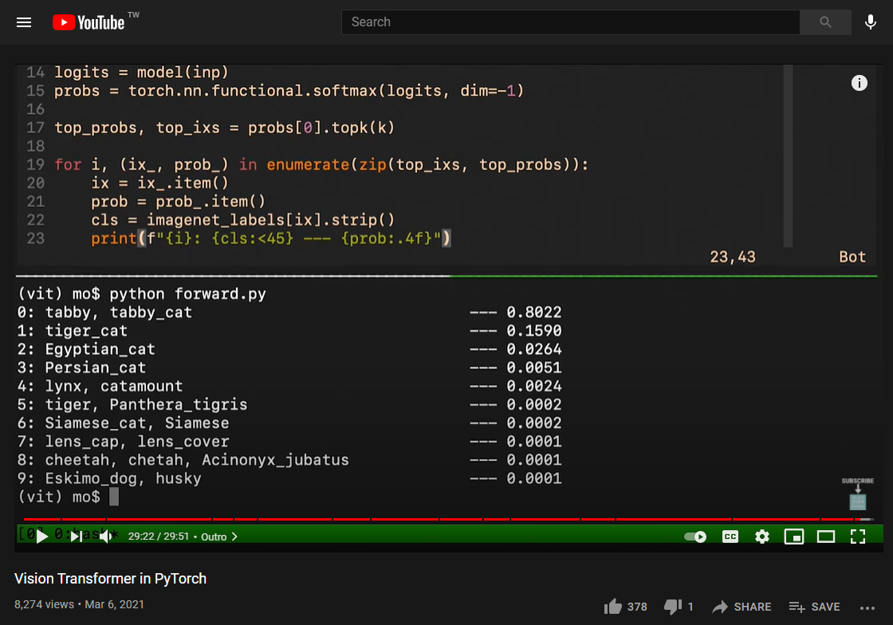
Vision Transformer
Vision Transformer in PyTorch – YouTube
Eric
202107/24

Slide 2
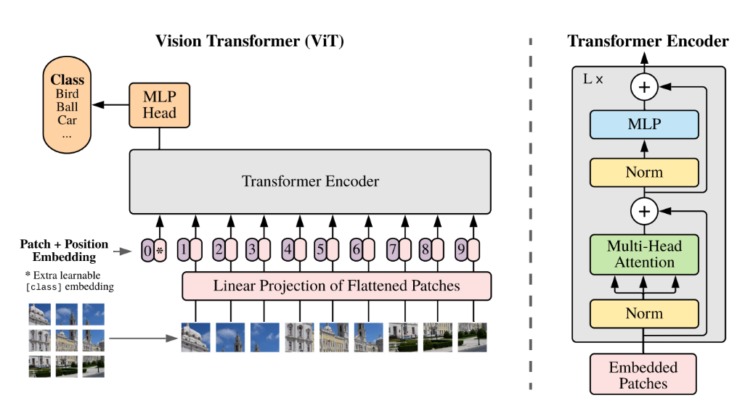
Outline
Patch Embedding Module
Attention Module
Multilayer Perceptron
Block Module
Vision Transformer
XAI

Slide 3
Patch Embedding Module
Patch Embed.
Attention
M.L.P.
Block
Vision Trans.
XAI

Slide 4
Patch Embedding Module
To-do List:
Split an image into several patches.
Embed/ Map the patches.
We’re about to see the smartness of CV Pro about how they make use of conv module.
Init: (Create a module)
def __init__ (img_size, patch_size, in_chans, embed_dim)
Input:
(n_samples, in_chans, img_size, img_size)
Output:
(n_samples, num_patches, embed_dim)
Wait! What about little purple pill?
Patch Embed.
Attention
M.L.P.
Block
Vision Trans.
XAI
Output
n_samples, num_patches, embed_dim
Patch Embedding Module
img_size, patch_size, in_chans, embed_dim
Input
n_samples, in_chans, img_size, img_size

Slide 5
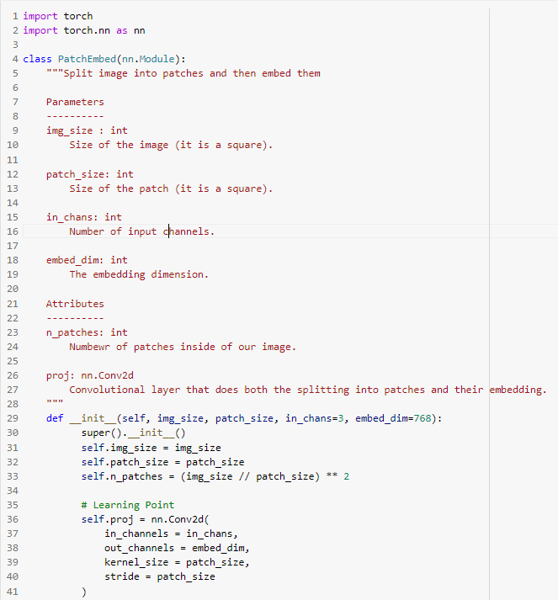
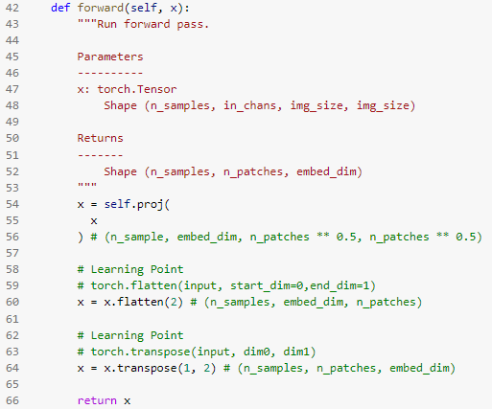
Patch Embedding Module
Patch Embed.
Attention
M.L.P.
Block
Vision Trans.
XAI
Output
n_samples, num_patches, embed_dim
Patch Embedding Module
img_size, patch_size, in_chans, embed_dim
Input
n_samples, in_chans, img_size, img_size

Slide 6
Attention
Patch Embed.
Attention
M.L.P.
Block
Vision Trans.
XAI

Slide 7
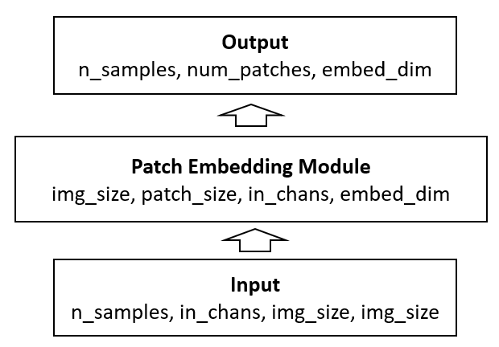
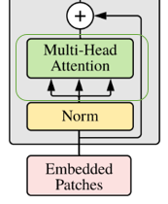
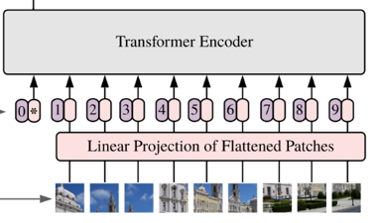
Attention
To-do List:
Apply attention mechanism into our input.
Wait! What is our input?
Init:
def __init__ (dim, n_heads, qkv_bias, attn_p., proj_p)
Input:
(n_samples, n_patches + 1, dim)
Output:
(n_samples, n_patches + 1, dim)
Wait! Why is our input dim. equals to output dim. ?
Patch Embed.
Attention
M.L.P.
Block
Vision Trans.
XAI
Output
n_samples, num_patches + 1, embed_dim
Attention
dim, n_heads, qkv_bias, attn_p., proj_p
Input
n_samples, num_patches + 1, embed_dim

Slide 8
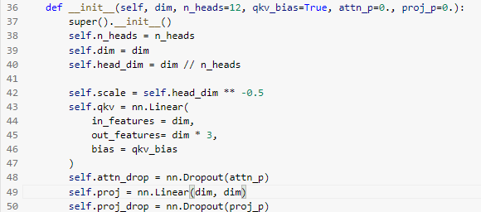
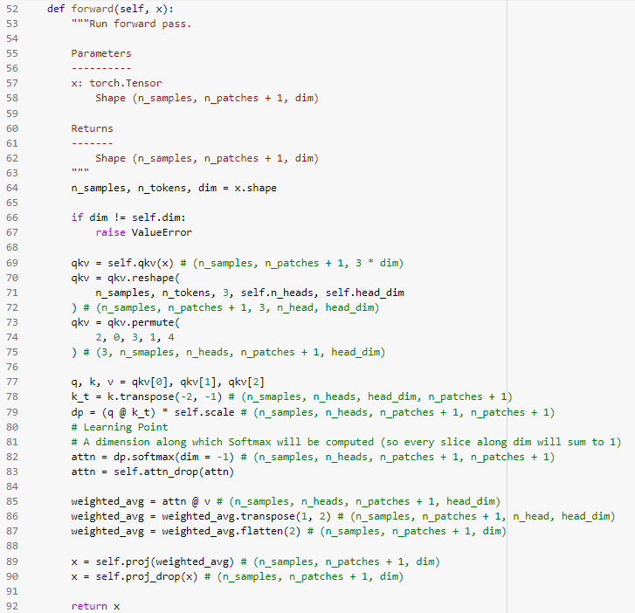
Attention
Patch Embed.
Attention
M.L.P.
Block
Vision Trans.
XAI
Query
Key
Output
n_samples, num_patches + 1, embed_dim
Attention
dim, n_heads, qkv_bias, attn_p., proj_p
Input
n_samples, num_patches + 1, embed_dim

Slide 9
MLP
Patch Embed.
Attention
M.L.P.
Block
Vision Trans.
XAI

Slide 10
MLP
To-do List:
Multi-Layer Perceptron
Init:
def __init__ (in_features, hidden_features, out_features, p)
Input:
(n_samples, n_patches + 1, dim)
Output:
(n_samples, n_patches + 1, dim)
Wait! Why is our input dim. equals to output dim. ?
Patch Embed.
Attention
M.L.P.
Block
Vision Trans.
XAI
Output
n_samples, num_patches + 1, embed_dim
MLP
in_features, hidden_features, out_features, p
Input
n_samples, num_patches + 1, embed_dim

Slide 11
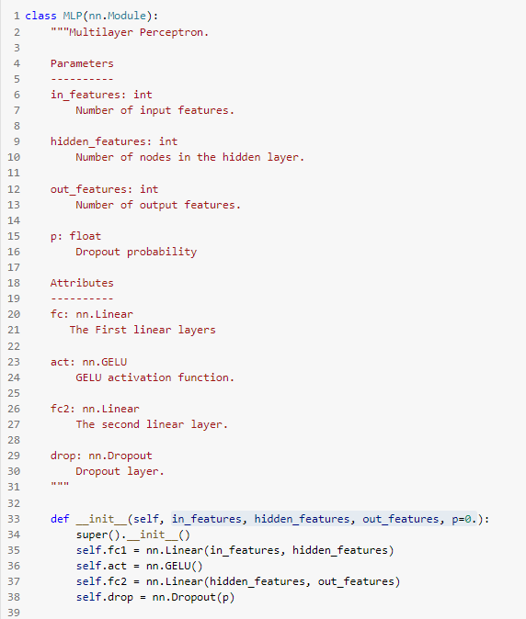
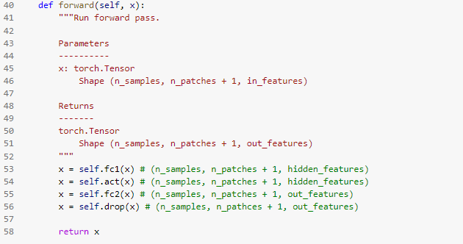
MLP
Patch Embed.
Attention
M.L.P.
Block
Vision Trans.
XAI
Output
n_samples, num_patches + 1, embed_dim
MLP
in_features, hidden_features, out_features, p
Input
n_samples, num_patches + 1, embed_dim

Slide 12
Block
Patch Embed.
Attention
M.L.P.
Block
Vision Trans.
XAI

Slide 13
To-do List:
Do normalization
Apply attention mechanism
Don’t forget skip connection
Do normalization again
Apply multi-layer perceptron
Don’t forget skip connection XD
And what?
Repeat!
Init:
Def __init__(params. we need in Attn. & M.L.P.)
Input:
(n_samples, n_patches + 1, dim)
Output:
(n_samples, n_patches + 1, dim)
Block
Patch Embed.
Attention
M.L.P.
Block
Vision Trans.
XAI
Output
n_samples, num_patches + 1, embed_dim
Block
Attention
MLP
Input
n_samples, num_patches + 1, embed_dim

Slide 14
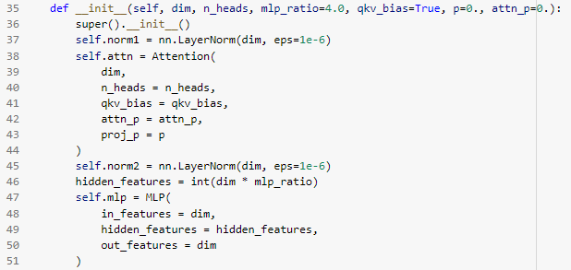
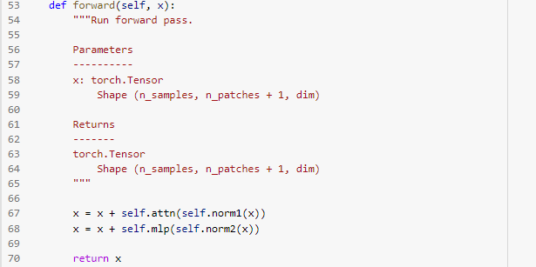
Block
Patch Embed.
Attention
M.L.P.
Block
Vision Trans.
XAI
Output
n_samples, num_patches + 1, embed_dim
Block
Attention
MLP
Input
n_samples, num_patches + 1, embed_dim

Slide 15
Vision Transformer
Patch Embed.
Attention
M.L.P.
Block
Vision Trans.
XAI

Slide 16
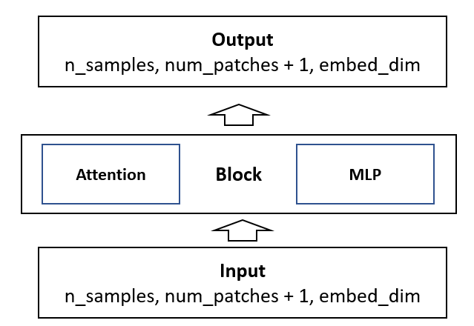

To-do List:
Luckily, we have a GIF to visualize everything.
Do patch embedding.
Add the so-called “class token”
Here comes the missing little purple pill! (Positional Encoding)
Pass everything into Transformer Encoder.
Use a (MLP) head to output probabilities.
Vision Transformer
Patch Embed.
Attention
M.L.P.
Block
Vision Trans.
XAI
Output
n_samples, num_class
Vision Transformer
Input
n_samples, in_chans, img_size, img_size

Slide 17
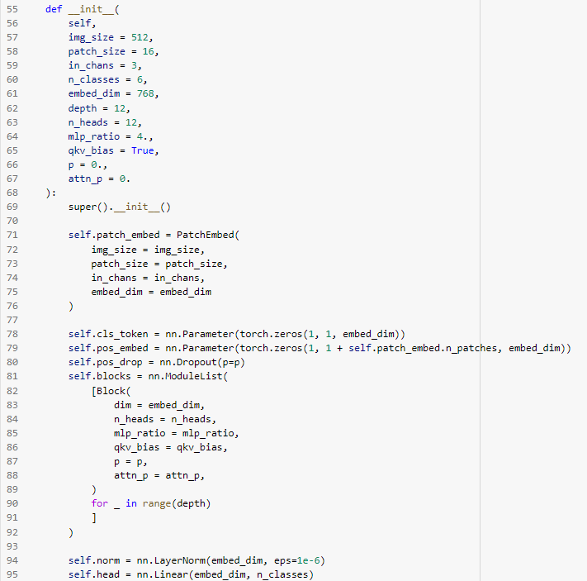
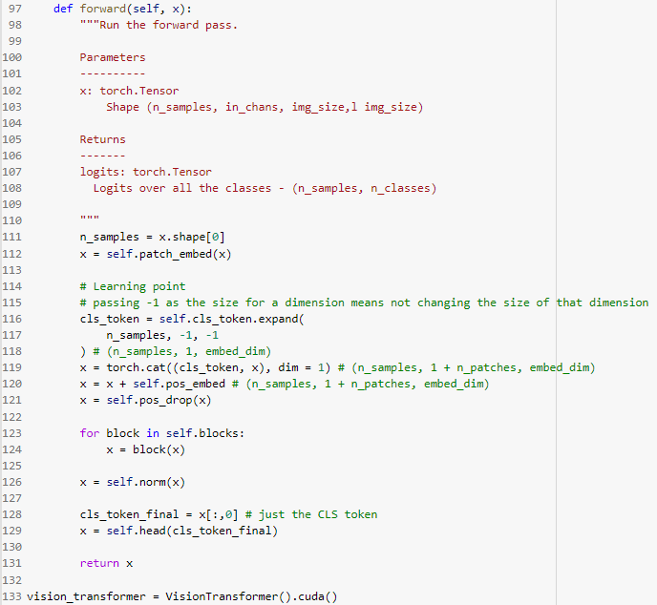
Vision Transformer
Patch Embed.
Attention
M.L.P.
Block
Vision Trans.
XAI

Slide 18
Take a break for 20 sec.
Okay, we have already run the notebook and it should be training now.
Now, what kind of data we are using now?
AOI defect detection
And we will start to introduce XAI.

Slide 19
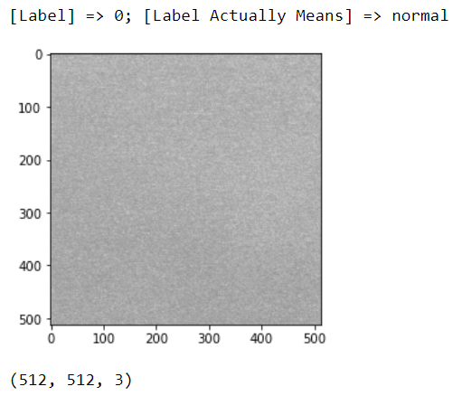
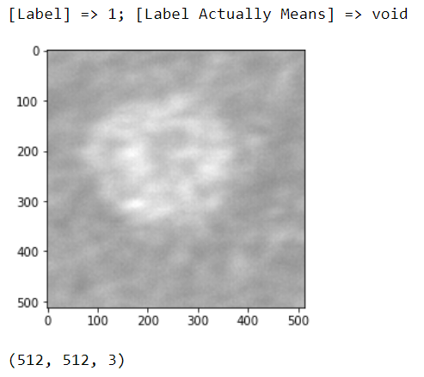
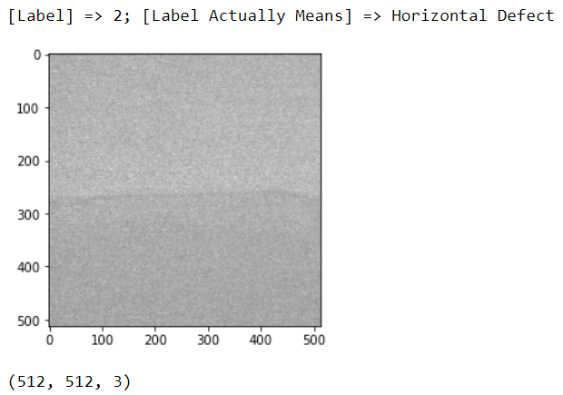
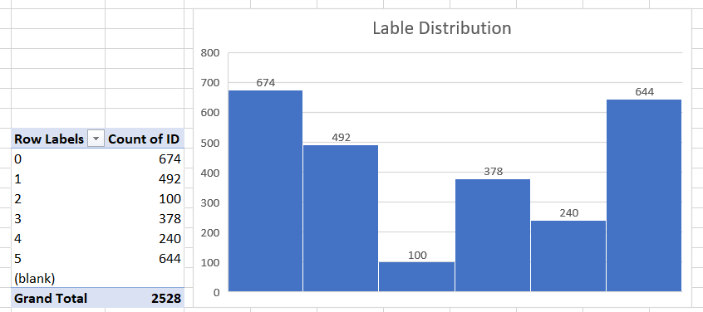
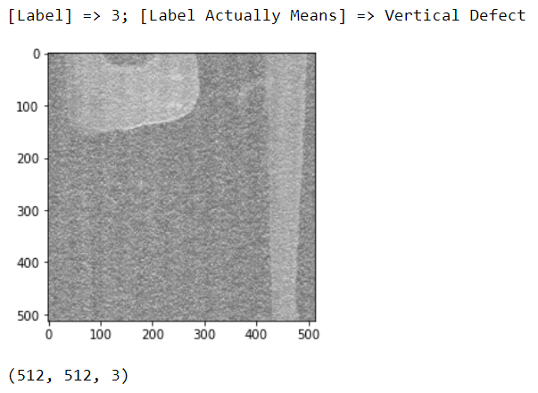
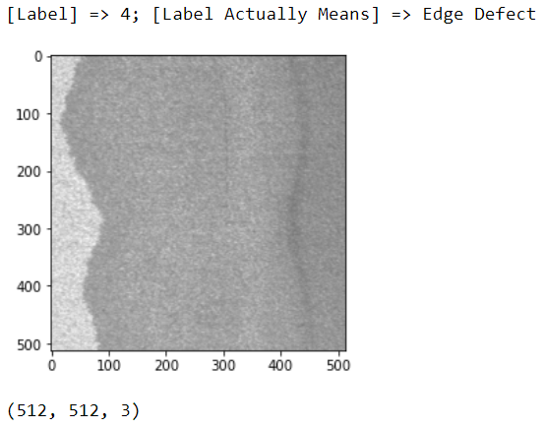
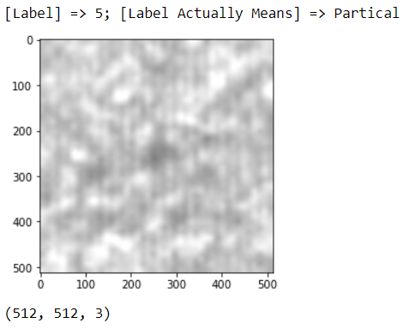
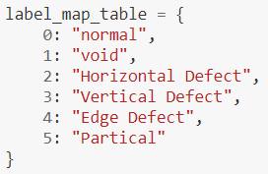
Training: #2500 Testing: #10000

Slide 20
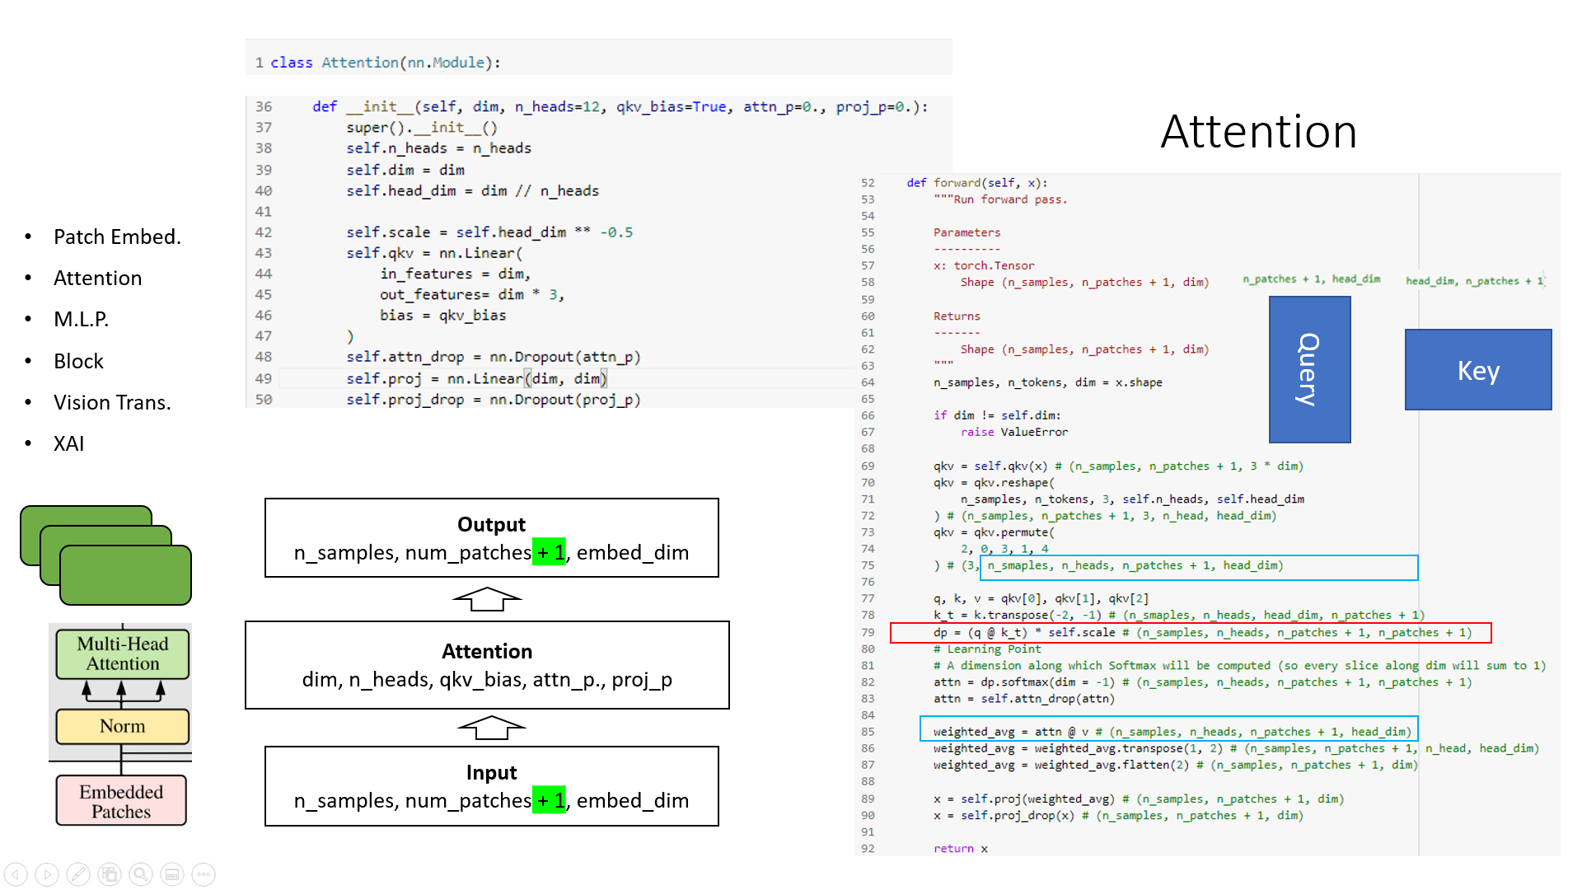
XAI
XAI
Explainable AI
Motivation
To better the model performance.
To better understand what is undergoing inside the black box.
What could be the keys of Vision Transformer?
“Attn_drop” layer
See page 8 in this slides.
Others?
CNN: Feature Map Visualization, Kernel Visualization, GradCAM
Patch Embed.
Attention
M.L.P.
Block
Vision Trans.
XAI

Slide 21
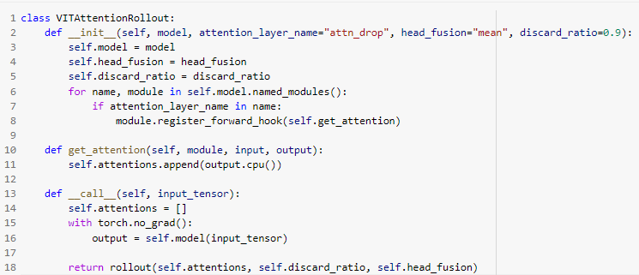
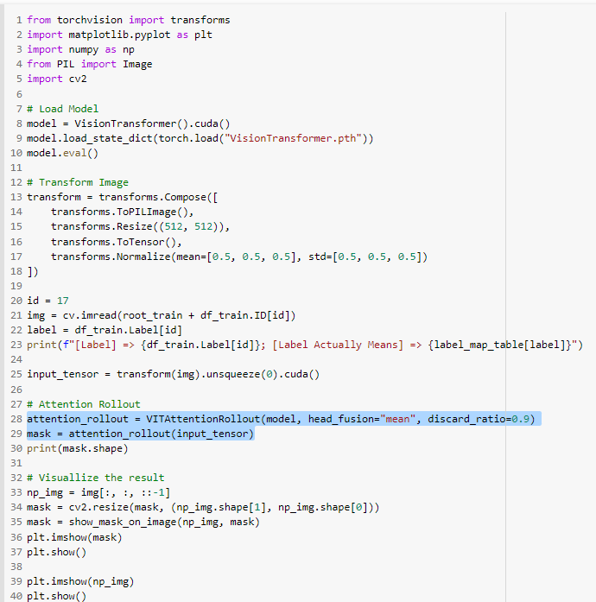
XAI
REF:
jacobgil/vit-explain: Explainability for Vision Transformers (github.com)
Patch Embed.
Attention
M.L.P.
Block
Vision Trans.
XAI
Attn_drop：n_samples, n_heads, n_patches+1, n_patches+1
n_patches = 32 x 32
32 = 512 / 16, where 512 = image_size, 16 = patch_size

Slide 22
Colab Time

Slide 23
Reference
[LINK] Eric’s Colab Notebook ➔ Vision Transformer + XAI
[LINK] YouTube Video ➔ Vision Transformer in PyTorch
[LINK] XAI ➔ vit-explain
[LINK] Details. about what we’ve talked about AOI and PyTorch

